Slide 1
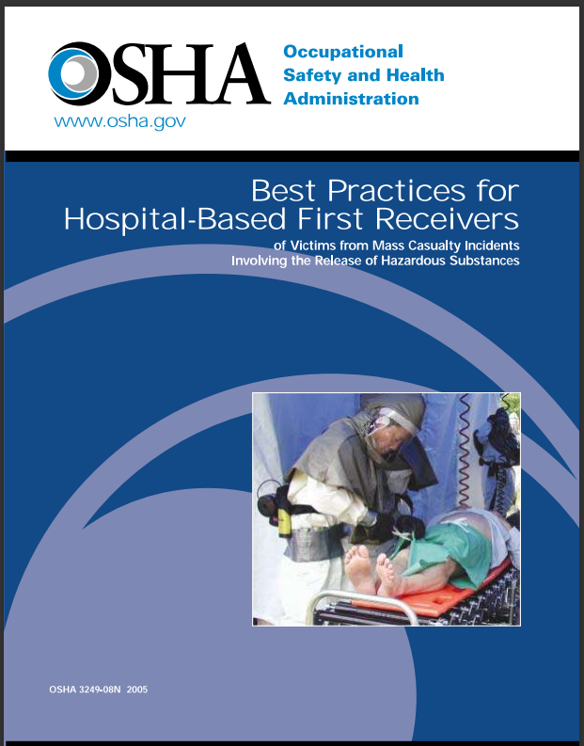
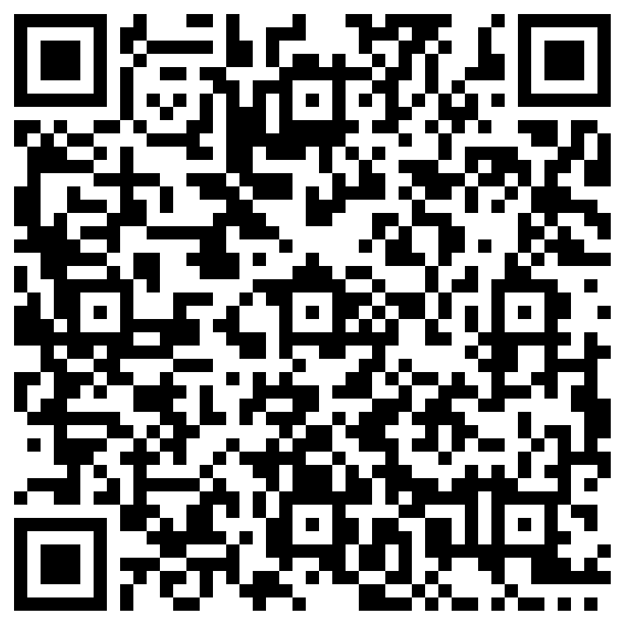
Is your hospital OSHA compliant?
Free FEMA HERT 8-hour VILT
  Hospital Emergency Response Team
    March 16th – 19th, 2026
    September 21st – 24th, 2026
      0800-1000 or 2000-2200 daily
        Virtual Instructor Lead Training
          Free 8-hours of CEUs
OSHA requires hospitals to have 24/7/365 decontamination capabilities; Just-in-Time training is not allowed.
This course meets the didactic requirements
  Topics covered include: PPE, NIMS & HICS, Triage, Hospital Decontamination, Exposure to Hazardous Substances, & Emergency Treatment Area.
Course is open to all Healthcare, EMS, EM, Fire/Rescue, LPH, Students, Volunteers, etc...
Contact millerdav@centracare.com or mitchell.miller@centracare.com with questions...

